Slide 1








Using Predictive Analytics for to Associate Tolls and Damages to Customers
Industry Practicum Presentation
April 2025
Ananth Mohan
Farha Shireen
Hsueh-Ning Chao
Shih Min Lin
Tanvir Ahmed Farook
Yao Liu
Yijun Wang

Slide 2


A lot has happened in the last ~3 months
Week off | 20-Jan | 27-Jan | 3-Feb | 10-Feb | 17-Feb | 24-Feb | 3-Mar | 10-Mar | 17-Mar | 24-Mar | 31-Mar | 7-Apr | 14-Apr
Kickoff |  |  |  |  |  |  |  |  | Spring Break
Understanding industry and problem statement
Data understanding
Data preparation
Creating the Model
Final Presentation
Key Deliverables |  |  |  |  | First draft – Tolls Model |  | Final – Tolls model First draft - Damage Attribution Model |  |  | Final - Damage Attribution Model | Final Presentation
Kick-off
Today!
Project
Wrap-up

Slide 3
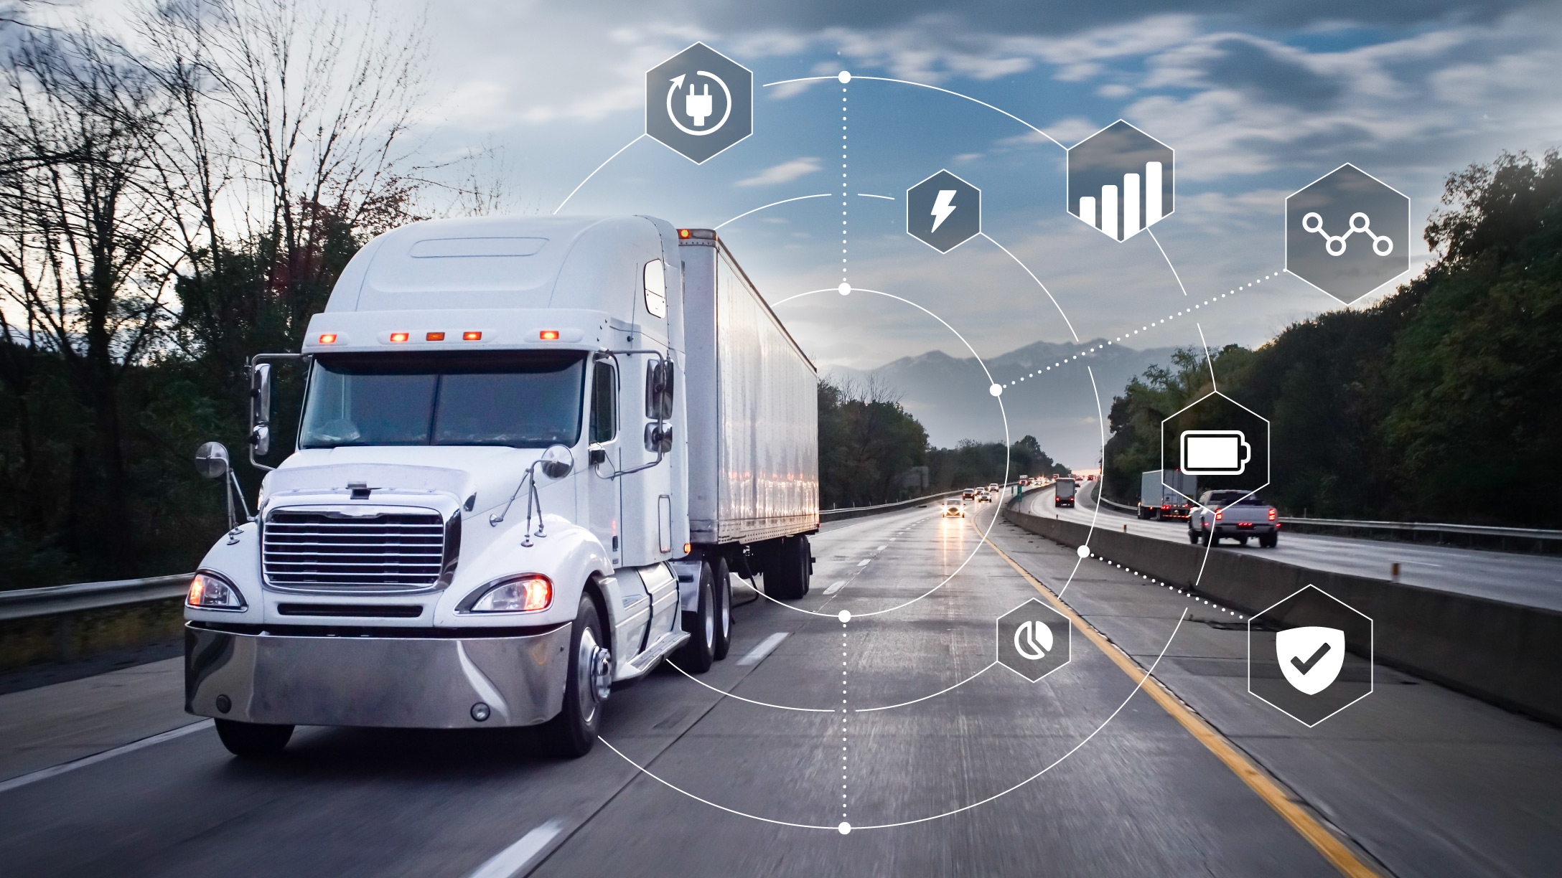
Today, we will cover....
Industry & Overview of the problem
Manage Tolls to improve attribution
Manage Damages to improve attribution
Data Modeling for Predictive Modeling

Slide 4




Wabash TaaS revolutionizes logistics, but comes with challenges
Trailer Rental
Multiple trips within subscription period
Customer 1
Customer 2
TaaS Platform
Trailer Subscription
Pre/Post Inspection Report
Assets & Service Management
Telematics & Trailer Analysis
Trips
Where tolls generated
Cause damage on trailers
Business Problem
Associate tolls charges and damage fees to the correct customers

Slide 5

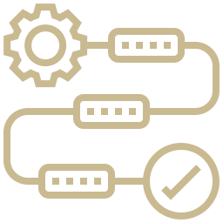

Data for attribution workflows help optimize operations and experience
Automate manual workflows
Accelerate processing times
Enhance operational efficiency
Optimizes workforce expenses
Ensure accurate cost allocation
Mitigate hidden costs (e.g., tolls, damages)
Reduce overall operational expenditures
Streamline Operational Expenditures
Reduce operational disputes
Minimize customer complaints
Enhance satisfaction and foster loyalty
Improves Customer Experience
Notes:
As we continue to refine and enhance the toll attribution process, we have identified three key recommendations that will further improve the process.
First, integrating with the toll system’s API. Currently, toll data must be uploaded manually every day, which is time-consuming and labor-intensive. By successfully connecting to the API, we can automate this process, significantly reducing the time required for data uploads and minimizing the risk of human errors.
Second, continuous monitoring and optimization. While our current solution has improved accuracy, there is still room for enhancement. By closely monitoring toll attribution results, we can identify and correct inaccurate billings in real-time, further increasing accuracy over time and ensuring that customers are always charged correctly.
Third, integrating with the client’s portal. Right now, billing notifications and invoices require additional manual effort. By linking the toll attribution system with the client’s portal, we can automate the sending of notifications and invoices, ensuring a seamless and more efficient billing experience for both the company and its customers.

Slide 6
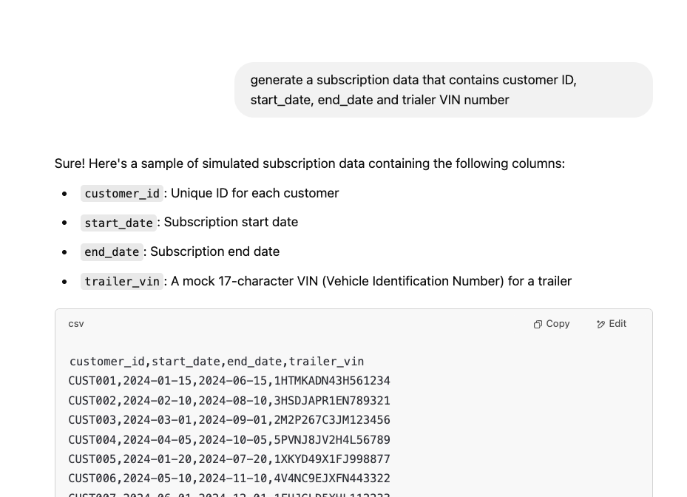
Due to customer confidentiality, we used LLMs to create synthetic data
Raw Data Received from Wabash
Used LLMs to create synthetic data
Asset Location (Telematics)​​
Trailer, Location, Motion Status, Timestamps, ...
Tolls Records Entry/Exit Plazas​​, Toll Charges​​, Dispute Status​​, Timestamps​​, ...
Inspection Records
Inspection Types, User Metadata, Timestamps, ...

Slide 7




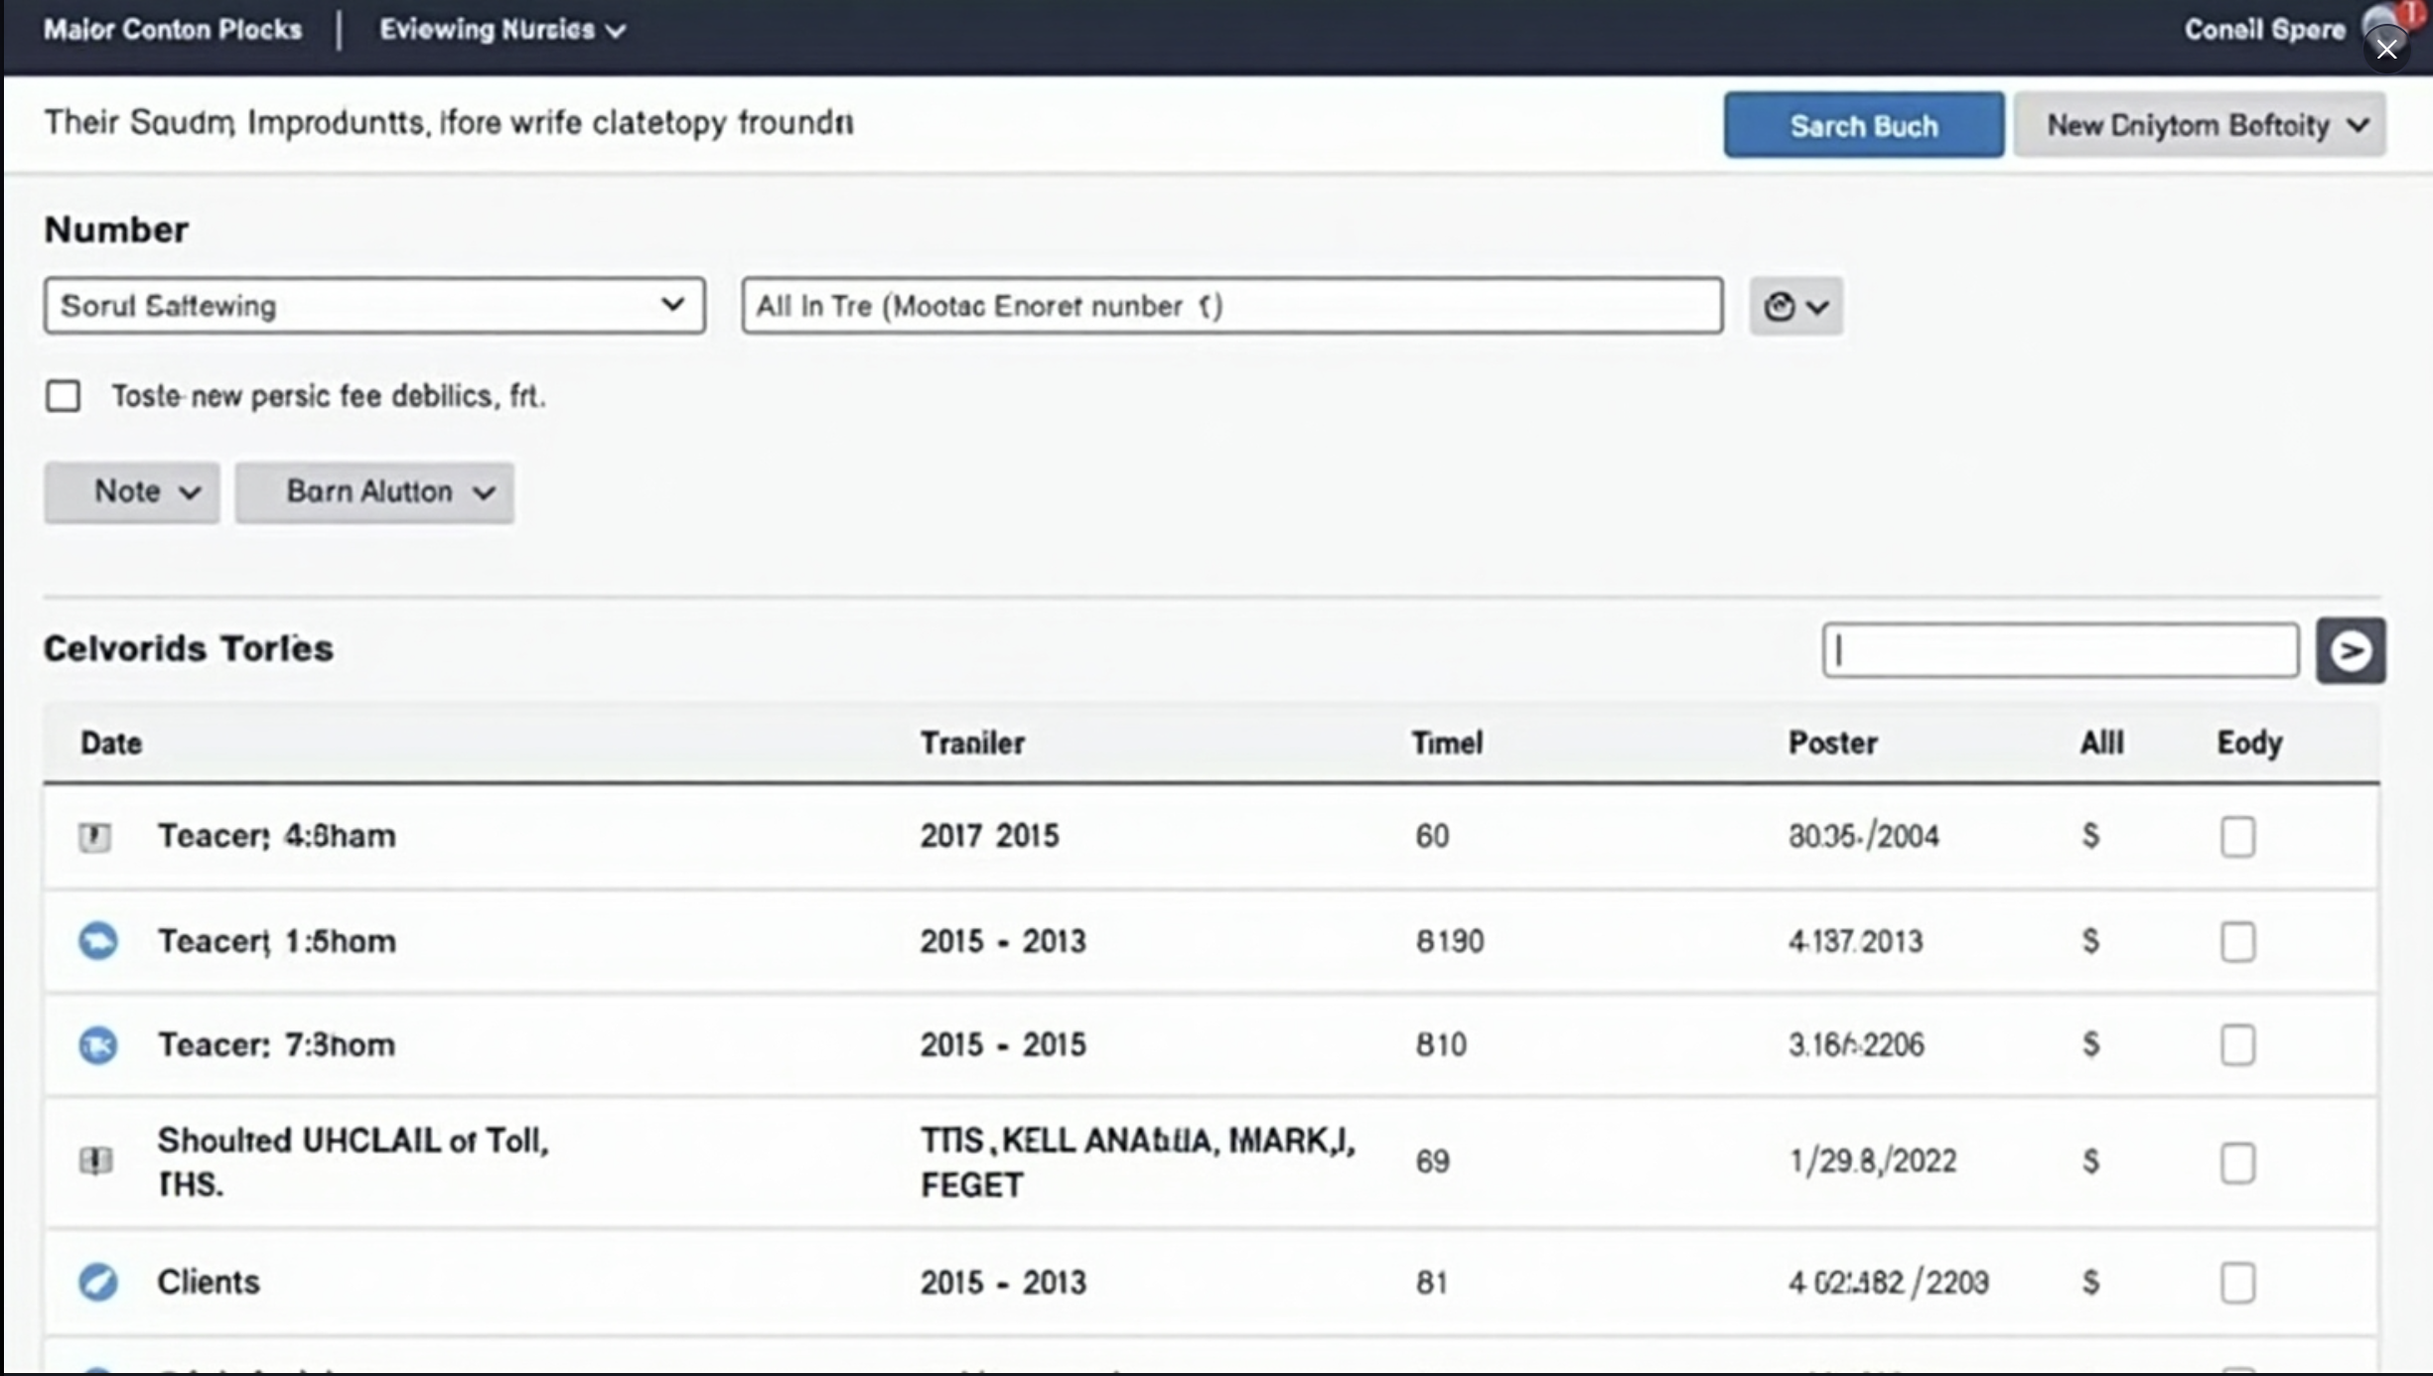
Manual matching of Tolls can cause cost leakage and inaccuracies
Date + UID of trailer
Tolls Data
Subscription Data
Date Filter
Trailer Filter
Manual Attribution
Inaccurate Billing
Toll Attribution
Time-consuming
Revenue leakage
Inaccuracy risk
Search Results
Date
VIN
Toll Amount
Customer_id
Potential Dispute
Billing Delays
Using SQL to match customer to the Toll charge for easy follow-up
Notes:
The toll attribution process is currently being done manually, which takes a lot of time and effort. We identified three key challenges that impact this operation.
First of all is that the process can be extremely time-consuming. Matching toll records with customer subscriptions manually slow down the operation and increase workload.
Second, manual attribution introduces a risk of inaccuracies. With high transactions or having short subscription period, the toll attribution process would be harder and might further cause inaccurate attribution or generate more missed tolls, which can lead to billing disputes and potential revenue loss.
Third, billing delays make it difficult for Wabash to charge customers in a timely manner. Since the process requires multiple steps before finalizing charges, it affects both operational efficiency and cash flow.
As the business grows, these challenges will only increase. That’s why we developed an automated solution designed to streamline the toll attribution, ensuring efficiency, accuracy, and timely client charges—so you can focus on scaling the operations rather than fixing billing errors.
Our solution works by integrating the subscription data with toll records, automatically matching each toll charge to the correct customer using SQL and batch processing, which allows the system to conduct the matching process repeatedly.
Since the API problem with Prepass haven't been fixed yet, so the first step of this process would be upload the tolls data you received from Prepass everyday and set up Batch to repeat the mapping process daily, after the mapping process is done, the result will be shown in the toll attribution table with date, VIN, toll Amount, Customer ID. This result can further be exported for future use.
After adopting this automation, we can have accurate attribution and time used for this process can be decreased significantly, another key improvement is timeliness. With automation in place, we can now process toll charges much faster, which allows us to bill the customer more promptly.

Slide 8



This solution can be further improved using appropriate integrations
Prepass API
Monitor and Optimize
Integrate with Portal
Successfully connected to toll system's API can reduce the time that are used to manually upload the toll data everyday
Continuously monitor toll attribution results, focusing on identifying and addressing inaccurate billings to enhance accuracy over time
By integrating the toll attribution data with the portal, by sending billing notification and invoices through portal
Notes:
As we continue to refine and enhance the toll attribution process, we have identified three key recommendations that will further improve the process.
First, integrating with the toll system’s API. Currently, toll data must be uploaded manually every day, which is time-consuming and labor-intensive. By successfully connecting to the API, we can automate this process, significantly reducing the time required for data uploads and minimizing the risk of human errors.
Second, continuous monitoring and optimization. While our current solution has improved accuracy, there is still room for enhancement. By closely monitoring toll attribution results, we can identify and correct inaccurate billings in real-time, further increasing accuracy over time and ensuring that customers are always charged correctly.
Third, integrating with the client’s portal. Right now, billing notifications and invoices require additional manual effort. By linking the toll attribution system with the client’s portal, we can automate the sending of notifications and invoices, ensuring a seamless and more efficient billing experience for both the company and the customers.

Slide 9
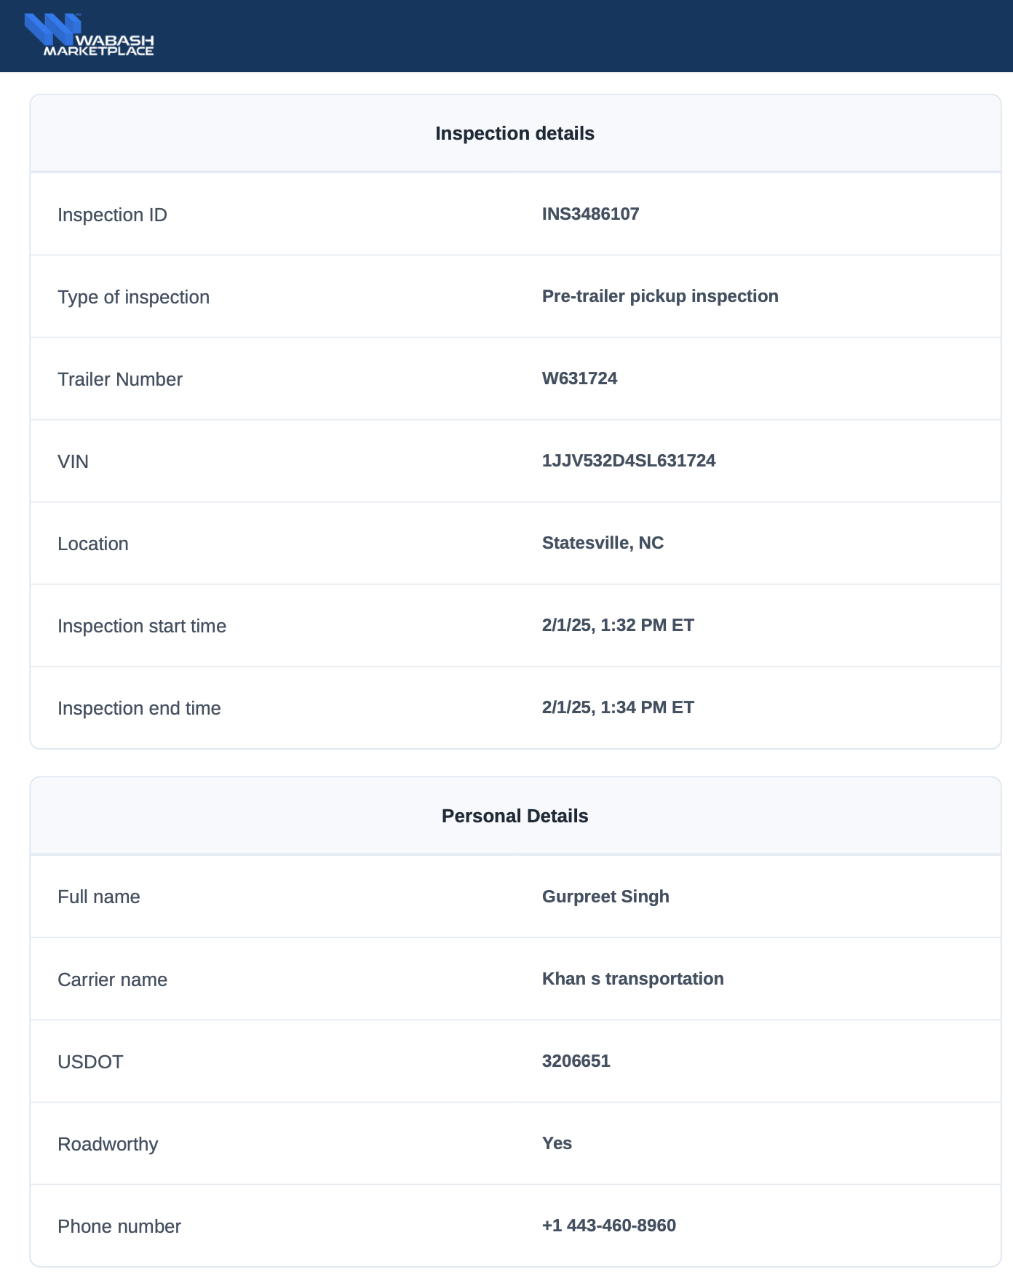

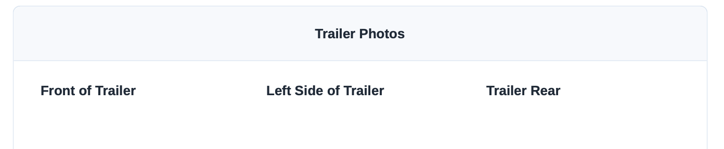

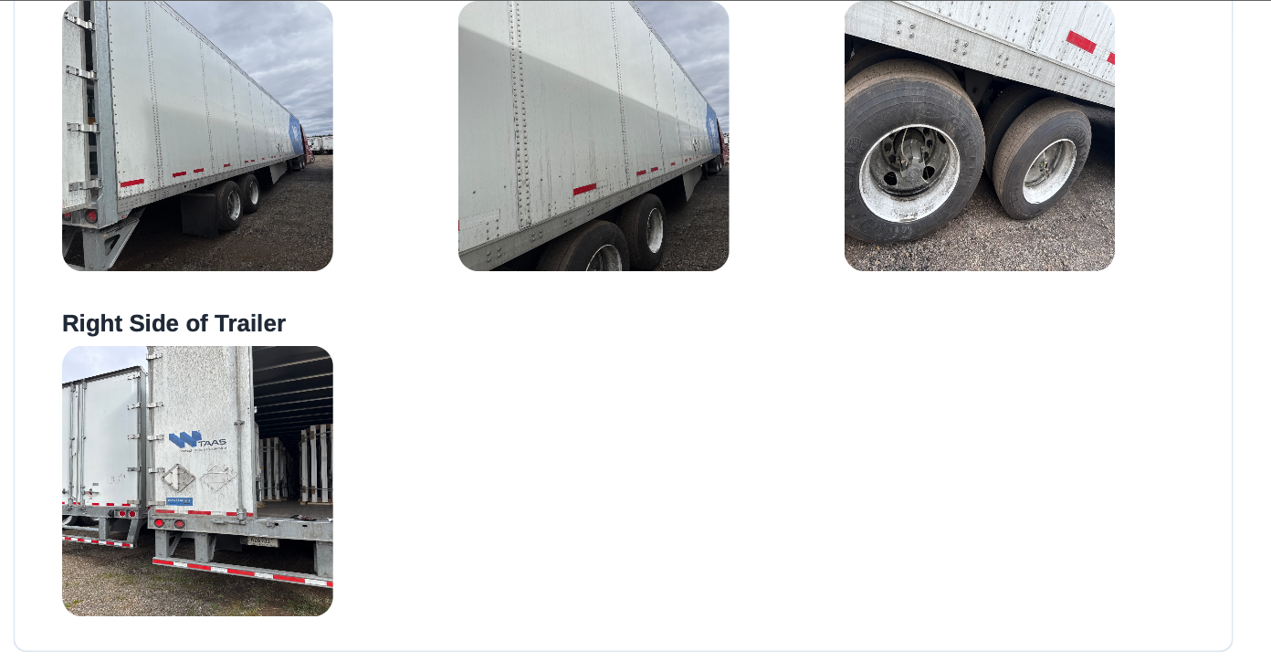

Manual scanning of inspection report is cumbersome and not scalable
Driver adherence to filling inspection reports
Manual Review causes delay and inaccuracies
Frequent trailer handover complicates ownership

Slide 10
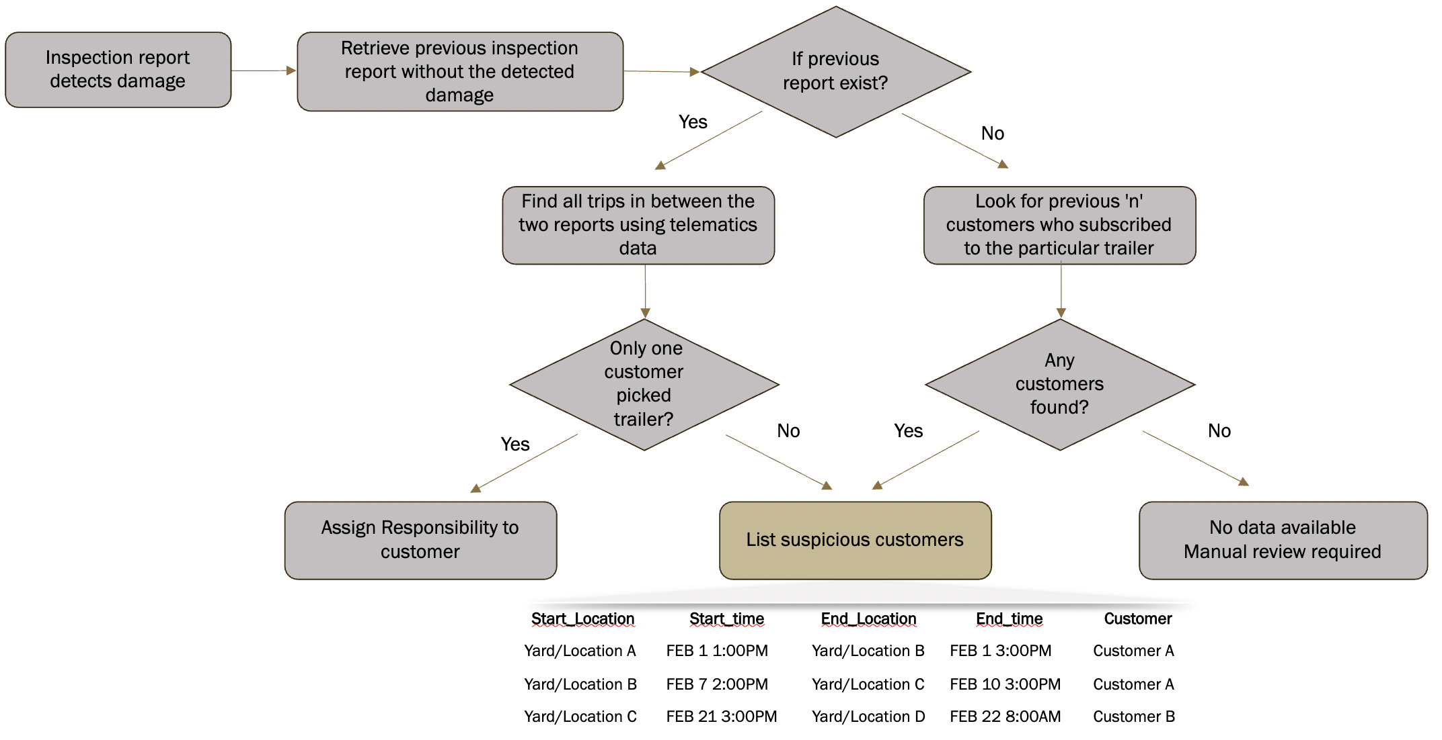
Inspection reports with telematics can provide potential drivers
Key Parts of Damage Solution
Recent Clean Inspection Report as the Starting Point
Matching with Telematics Data
Tiered Attribution Logic
Benefits
Works even if reporting isn’t enforced
Avoids subjectivity, improves accuracy
Enables fairer attribution
Automates damage attribution at scale with traceable outcomes

Slide 11
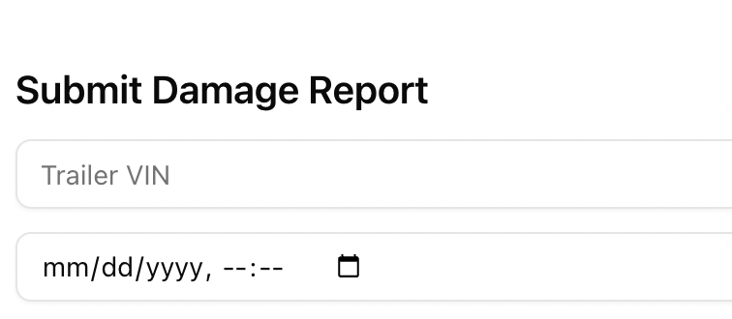
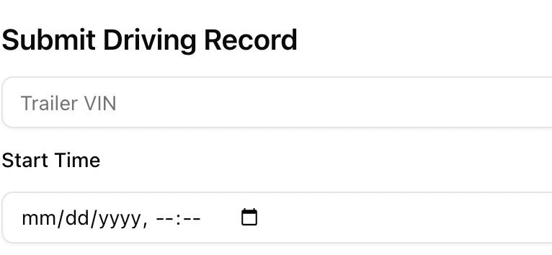
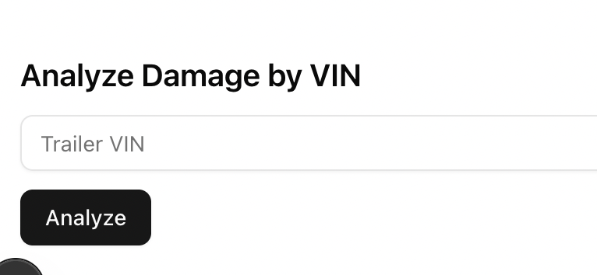
We created a website to demonstrate sample output
Web UI enables inspection and telematics submission
Backend logic matched reports with customer activity
Results are displayed instantly with status + movements

Slide 12
Damages Demo Video

Slide 13







Supplementing data can help find the most likely driver
External APIs
Historical Patterns
Weather
Trip Recency
Time of Day
Sensor
Predictive Model
"Most likely
Driver"!
List of Possible Customers
Overload
Route History
Driver Behavior
Notes:
In the scenario where we have more than one suspicious driver, we would suggest using a predictive model to predict the degree of suspicious for a driver based on the features above, such as the weather condition, time of day, load weight, recency of a specific trip and also use the route history data to see how often does a specific route has damage occurred. After runniung the model, a score will be estimated for each driver based on the features. This score allows us to target the most suspicious driver in the list.

Slide 14

Roadmap from data collection to data-driven
1 - Foundational Data
2 – Understanding the Data
Preparation & Pipelines
Set up robust ETL pipelines using tools like Airflow, Fivetran, or dbt
Automate data ingestion and transformation
Track data lineage and version history
Exploratory Analysis
Conduct descriptive statistics & data visualization
Identify trends, anomalies, outliers and their reasons
Feature Engineering
Use Domain-specific knowledge to transform raw data into meaningful features
Relevance & Representativeness​
Collect the right data aligned with business and modeling goals​
Integrity & Quality​
Validate accuracy, consistency, and completeness​
Structure & Storage​
Use standardized schemas and naming conventions​
Store data in scalable, cloud-friendly systems like BigQuery or Snowflake​

Slide 15

Advanced modeling can reduce manual efforts and improve accuracy
3 – Advanced Modeling with Data
What
How
Why
>
Automate toll updates and payment tracking
Integrate toll, trip, and payment data to build a real-time status engine using rule-based and ML logic
Save operational time and reduce billing errors
>
Identify damage-prone situations and trigger alerts
Analyze trip conditions, speed, route data, sensor data and past incidents using anomaly detection models
Avoid breakdowns and plan servicing proactively
>
Predict trailer maintenance needs using sensor data
Use time-series modeling on telematics and sensor data (e.g., temperature, vibration) to forecast failure points
Reduce maintenance costs and improve trailer uptime
>
Profile driver behavior from telematics data
Aggregate acceleration, braking, and deviation data to score drivers using clustering or supervised models
Improve safety, assign risk scores, and incentivize good driving​​

Slide 16

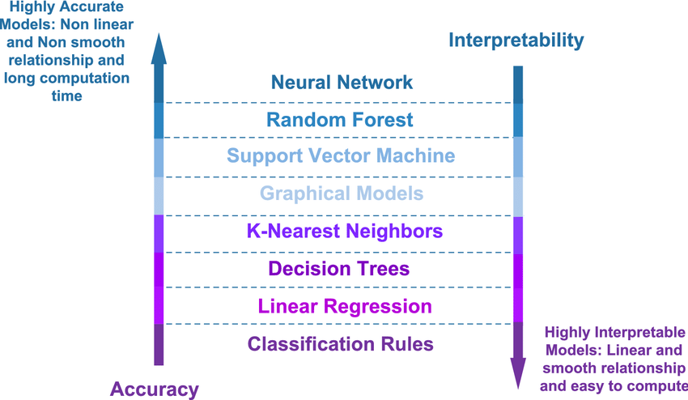

Turning Data into Trust: From Costly to Intelligent
Highly Accurate
Models: Non-linear and non-smooth relationship and long computation
time
Damage attribution goes beyond billing — it's about establishing trust and good driver practices
Wabash can lead by delivering fairness, transparency, and intelligent insights in TaaS
Highly Interpretable​ Models: Linear and smooth relationship and easy to compute
Human attribution demands interpretable models to shift from reactive responses to predictive intelligence

Slide 17
Recommendations on data modeling and how to organize the DB
Drivers
Customer
Tolls
Payments
are done by
requires customer
have to pay
Subscriptions
Trips
takes
includes
should complete
Inspection Reports
Damages
help to track
Trailers
can be tracked
Telematics
Maintenance Records

Slide 18
Capture the right fields for each table to create effective models
Table | Fields (assumes unique ID is present)
Customer | company_name, subscription_status, subscription_length, assigned_trailer
Trailer | vin_number, asset_availability, subscriber, subcribed_length, sensor_related_fields
Subscription | subscriber_name, start_date, end_date, subscription_type
Trips | subscription_id, vin_number, start_time, end_time, departure_network, return_network, toll_pass
Drivers | driver_name, company_name, vin_number, departure_time, arrive_time
Tolls | vin_number, entry_date, exit_date, toll_charge
Payments | company_name, trip_id, report_id, invoice_date, payment_status, total_fee
Inspection Reports | report_id, vin_number, company_name, inspection_type, damage_or_not, created_time
Damages | vin_number, damage_part, severity, report_date, charge_back, responsible_customer, estimate_cost
Telematics | vin_number, position, asset_motion_status, report_time
Maintenance | report_match, maintenance_status, maintenance_cost, start_date, finished_date, charge_back

Slide 19
can we clarify anything?
Thank you for your Attention!

Slide 20

Purdue Team
Ananth Mohan
Farha Shireen
Hsueh-Ning Chao
Shih Min Lin
mohan52@purdue.edu
lnuf@purdue.edu
chao77@purdue.edu
lin1944@purdue.edu
Tanvir Ahmed Farook
Yao Liu
Yijun Wang
Under the guidance of Dr. Shoaib Khan
tfarook@purdue.edu
liu4091@purdue.edu
wang6665@purdue.edu​
khan180@purdue.edu ​

Slide 21
Toll Aggregator sents Daily Toll Data Report to Wabash for Reimbursement
Automation Logic
Matching Subscriber to Tolls
Update Database with matched data
Trailer Subscription Information
Send out emails to customers with Toll amounts
TOLLS – Customer identification

Slide 22

Business Background
Rent trailers to
Have multiple trips during the subscription period
Subscribers
TaaS
Trailer Subscription
Assets & Service Management
Telematics & Trailer Analysis
Trips
Generate tolls
Cause damage on trailers
Business Problem
Associate tolls and damage to the corresponding parties
Inaccurate billing
Triangulate

Slide 23
Potential Solution: Toll Attribution
Process
Exit Date + UID of trailer
Start Date + End Date + UID of trailer
Upload tolls data to database daily
Set up Batch to repeat the mapping work automatically (Daily)
The mapping result will be update to the new table(Toll attribution)
The person who's in charge of Tolls can use the simple web to search for tolls information
Tolls Data
Subscription Data
Date Filter
Trailer Filter
Toll Attribution
Search Results
Date
Trailer Number
Toll Amount
Customer_id
Status

Slide 24
Can we triangulate driver name of Toll from inspection report
Trailer Moves​
Trailer picked from Location A
Pre Inspection Report
Toll
Trailer stopped at location B
Post Inspection Report
Driver_name from Last inspection report of VIN after toll_created_time
Driver_name from First inspection report of VIN after toll_created_time
Matching these can help match some* tolls to drivers
*Caveat: Accuracy depends on adherence to filling inspection report.

Slide 25
Potential Solution: Flat-Rate Subscription for Tolls
Goal
How does it solve the current challenges?
Upfront collection of potential toll cost
Current Challenges | Flat-Rate Subscription Solution
Tolls needed to be associated in timely manner | Collect tolls fee before service
Limited data from customers side | No need to rely on customers' data
Trailers being used by multiple carriers | Segment-based tolls fee
Business Model
Collect fixed amounts, segment-based of toll fee from customers prior the service, give them back if they didn't pass the toll.
The initial toll fee is unchanged whether the trailer passes through zero or multiple checkpoints
How to find the amounts of toll to charge?
Predictive Model
Subscription Toll Fee
Average tolls fee in region

Slide 26
If previous report exist?
Inspection report detects damage
Retrieve previous inspection report without the detected damage
Yes
No
Find all trips in between the two reports using telematics data
Look for previous 'n' customers who subscribed to the particular trailer
Only one customer picked trailer?
Any customers found?
Damages – potential Customer identification
Yes
No
Yes
No
Assign Responsibility to customer
List suspicious customers
No data available
Manual review required
Start_Location | Start_time | End_Location | End_time | Customer
Yard/Location A | FEB 1 1:00PM | Yard/Location B | FEB 1 3:00PM | Customer A
Yard/Location B | FEB 7 2:00PM | Yard/Location C | FEB 10 3:00PM | Customer A
Yard/Location C | FEB 21 3:00PM | Yard/Location D | FEB 22 8:00AM | Customer B
DAMAGES – Customer identification
Find who might be responsible
(identify all trips occurred in this period)
Potential Trips which could have caused the damage
VIN | Start_time | End_time | Customer
001234 | FEB 1 1:00PM | FEB 1 3:00PM | Customer A
002468 | FEB 7 2:00PM | FEB 10 3:00PM | Customer A
001369 | FEB 21 3:00PM | FEB 22 8:00AM | Customer B
Questions Regarding Damages: 1. Based on our current understanding and data we can identify list of "suspicious" customers. Is that what you are looking for?

Slide 27
Potential Solution for Damage Attribution – Inspection reports
Retrieve Dataset
(Get pre/post report)
Track VIN
(Find relevant images)
Preprocess Images
(Fix lighting, angle, etc.)
Detect changes without comparison
(CAM model)
NO
Classify damage types(optional)
(MobileNetV2 model)
Check Image Availability
(do pre-report have image?)
Compare pre & post images
(SSIM model)
Yes

Slide 28
Potential Solution for Damage Attribution – Model comparison
Model | Business Benefit | Use Case
SSIM | Fast, automated damage verification | Compare past & present images to detect new damages
CAM | Automated damage detection without history data | Finds damage in trailers with no past inspection images
MobileNetV2 | Classifies damage types & cost estimation | Helps insurers & fleet managers categorize and assess repair costs

Slide 29
Potential Solution for Damage Attribution
Check closest post-report prior to the time
Pre-report
If Damage appears in
Yes
Post-report
Check if it’s also in the pre-report
No
Charge the driver associated in report
How?
SQL/Python to trace back the time on the report
Use Computer Vision/LLMs to identify the damage photo/descriptions appears in pre & post reports are the same.

Slide 30
Driver (may) complete Pre-inspection Report
Driver uses Trailer
Trailer Inspection Reports (Trailer Hawk)
Identify Damages using Computer Vision on images and text feedback
Loop through inspection reports to predict cause and time of damage
Driver (may) complete Post-inspection Report
Report Potential Cause and Time to Wabash

Slide 31
Do both report exist?
Detect Damage
Retrieve Reports
(find 2 closest report by time)
Yes
No
Find all trips in between
Find suspicious customers
Only one responsible party?
Any customers found?
Yes
No
Yes
No
Did the customer take multiple trips?
List suspicious customers
No data available
Manual review required
Yes
No
Check trips align with the damage
Compare two reports
Assign Responsibility
Find who might be responsible
(identify all trips occurred in this period)
Potential Trips which could have caused the damage
VIN | Start_time | End_time | Customer
001234 | FEB 1 1:00PM | FEB 1 3:00PM | Customer A
002468 | FEB 7 2:00PM | FEB 10 3:00PM | Customer A
001369 | FEB 21 3:00PM | FEB 22 8:00AM | Customer B

Slide 32
What you can expect in our Final Presentation
Working scripts/models for Tolls/Damages which integrates with the existing system
Analysis/Recommendations -
Potential data which could be collected which could improve future predictive models, and how those would be helpful
Strategies to improve customer/"customer's customer" adherence to policies
Roadmap based on industry practices/standards, containing project/steps which could improve Wabash's preparedness to be data-savvy with respect to Tolls and damages attribution

Slide 33
Other Ideas for Exploration
Toll
Idea | Impact
Dynamic Route Mapping & Toll Forecasting | Help forecasting the upcoming toll expense for Wabash to develop further business strategy.
Damage
Idea | Impact
Severity Scoring System | Optimize charging and maintenance decision.
Predicting damage through sensor data | Identify overall damage trends on specific part of trailers, help optimize maintenance decision.
Integrate damage expenses and telematics data to assess the demand for maintenance across the regional network. | Help optimize maintenance cost allocation across different networks.

Slide 34
Weekly Catchup 21-Feb

Slide 35
Trucking and Logistics Industry Players
Shipper
Shipper share shipping requests to Broker
Broker
Carrier
Wabash provides Trailers to Brokers
Carriers pickup requests from Brokers
Brokers do not provide Carrier and Shipper data to Wabash and hence associating Tolls and Damages becomes tough

Slide 36







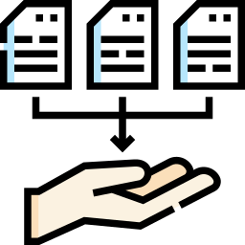
Niche Service
Foundation
Tech-driven
Niche Service
Collect basic data.
Ex. Subscriptions, Trips, Sensor
Integrate Sensor, Weather API data to build predictive models
Build platform ecosystem
Loyalty Program
Trailer tracking Portal

Slide 37
How we believe existing data can be connected
Booking/Subscription data can help us tie some 'party' to tolls/damages
Tolls
Amount
Created_at
Location
Vehicle_Number
Device_Plate_ID
Inspection Report
Type
Driver Name
Damage Details (Text/Images)
Subscription
Sub_start_time
Sub_end_time
Customer_ID
If Trip Identifiers does not exist, would using intelligence to identify this relationship be valuable to the project?
Booking
Booking_start_time
Booking_end_time
Customer_ID
Trip Identifiers
Semi-truck Identifier
Trailer Identifier
Start_time
End_time
Telematics
Created_time
Location
VIN

Slide 38
Business Problem as part of this Project
Is this a data/prediction problem or an automation problem?
Situation | Challenge | How does Solution look like? | What is required? | What does solution look like to you?
Toll reports come to Wabash in Excel Daily and Wabash sends to Customer | The tolls extract API isn’t working as expected and this is a manual process as of now | The solution should be able to parse the excel report, and update the Wabash portal the daily toll reports | Excel Report -> Python Script -> Update Wabash DB with required fields -> Emails the client with the report
Trailer damages are not captured on time | It’s a manual process on the Wabash side where a manual review of the inspection report is required and updates the Wabash portal | The solution should be able to parse the report and “notify” Wabash if there is a damage on the trailer | Inspection Report -> LLM and Computer Vision -> Update a DB with damage details -> Emails the client with the notification
Anything else??

Slide 39
Thanks for sharing the files!
Filename | Source & Frequency | What we think it is | Where they can be used
2025-01-16_20-16_W538040_Inspection_confidential.pdf 2025-02-01_18-34_W631724_Inspection_confidential.pdf | Wabash System, for each inspection report | PDF examples of pre and post inspection reports | Report which conveys status of a trailer at a certain point in time
inspections_extract_1_28_2025_confidential.csv | Wabash System, for each inspection report | Wabash DB extract which contains all inspection reports | Analyzing “data” column can help identify anomalies
asset_locations_sample_anon_1_28_2025_Confidential.xlsx | What is the source | Vehicle status with GPS data at 15-minute intervals, locating where the vehicles are at a certain time point | Link with tolls data to charge back on carriers
tolls_extract_1_28_2025_Confidential.csv | Toll Company | Tolls data provided by tolls-agent | Gives list of Tolls which needs to be associated with the Carriers
Network locations_Confidential.xIsx |  | Are they truck parking places? List of Brokers/Carriers? | Need to check importance of this to our project
otvi_Confidential.png |  |  | Need to check importance of this to our project

Slide 40
Customer Journey – Our Understanding
Customer picks up Trailer from Wabash trailer points
Customer fills pre-inspection report
Customer uses trailer to transport load (can do multiple loads, with different drivers)
Customer fills post-inspection report
Customer Drops Trailer to Wabash trailer points
If another load
Can incur toll
Trailer can get damaged

Slide 41
Weekly Catchup 21-Feb Agenda
What we would like to cover....
Damages
Solution – Pre and Post Inspection Image Comparison
Model Comparison
Tolls
Potential Solution – Merging Tolls and Subscription data using Batch
Questions
Questions regarding Asset data
(Disclaimer – these are initial solutions to refine our understanding and
initiate brainstorming ideas with you)

Slide 42
Weekly Catchup 12-Feb

Slide 43
Weekly Catchup 12-Feb Agenda
What we would like to cover....
General Questions
Question and Potential Solutions Tolls
Questions
Solution #1 - Finding Driver Details from Inspection Report
Solution #2 - Fixed charges while giving out the trailers
Damages
Questions
Solution #1 - Pre and Post Inspection Report Comparison – Text and Images
Some Additional Data which could be helpful
(Disclaimer – these are initial solutions to refine our understanding and
initiate brainstorming ideas with you)

Slide 44
General Questions
Questions
Is there a TaaS booking database – booking_start_time, customer_id, booking_end_time. This will help to identify the first customer point of contact. This will also help with verifying if inspection report was done or not.
Is the ‘license_plate_id’ in the tolls data for the truck and the ‘VIN’ for the trailer
What are the unique identifiers for trailer / semi-truck which Wabash use? - VIN is unique, trailer has decals which show unit number (LS24..... - last 6 of the VIN) Unit number (short hand) and VIN
Where do customers generally get the truck from? Is it pick-up locations, and after “drop trailers”?

Slide 45
Open Questions around Toll Attribution
Questions
How does PrePass and toll charging work?
If Wabash only provides the trailer, does the toll fee apply to the truck or the trailer? If the truck is charged, why is the trailer involved in toll calculations?
What is the current process around tolls after you receive the daily report?
Does the truck have their own license_plate – are they different - If Transponder, they get charges. If not, then it's the trailer which gets charged -> Company who's driving the truck is responsible for the toll amount. Mandate is not easy

Slide 46
Who's the target to be identified for Tolls
#1: To Identify Customer (not driver, but who leased out the Trailer)
Use Telematics data to identify the VIN of the trailer which can connect to Customer
Driver passes through a Toll
Wabash gets charged for Toll
What is the information sharing or What happens here?
Use Name on Inspection Report (Low adherence -> Low accuracy) to identify a driver
#2: To Identify Driver

Slide 47
Open Questions around Damage Attribution
Questions
What are the types of Damages Wabash is trying to identify? What details are perused in the report during the audit or manual review?
Body damages
Tyres
…. Need to identify if it's negligence or wear and tear
Does insurance cover damages? If so, what’s the objective behind attributing damages back to drivers?

Slide 48
What's the target for Damages
Damage can happen at ... | Who might be responsible | Type of damages | Can it be identified?
On the road | Driver, and which driver? | Collision, Structural Damages like dent and scratches
At the parked Yard, while loading | Location Personnel
Weather-related
Theft | Shouldn't happen as Telematics data can track this
Maintenance Issues | Wabash | Tyres, Engine part issues | Sensor data?

Slide 49
Weekly Catchup 05-Feb

Slide 50
Weekly Catchup 05-Feb
Today's Agenda
Align on Business Problem and expected final Deliverable
Understanding the files shared

Slide 51
Data Questions
Inspection/tolls
“trailer number” in inspection v.s vehicle number in tolls
what does “class” mean?
JSON: drivers detail are lost
Would you like to charge back on the carrier or the driver?
Networks
Are networks the location/company that can place the trailer? or carrier for Wabash(the TaaS provider, the broker)?

Slide 52
Weekly Catchup 27-Jan

Slide 53
Weekly Catchup 27-Jan
Today's Agenda
Align on overall business problem
What data is available, can be accessed?
Recurring weekly meeting time

Slide 54
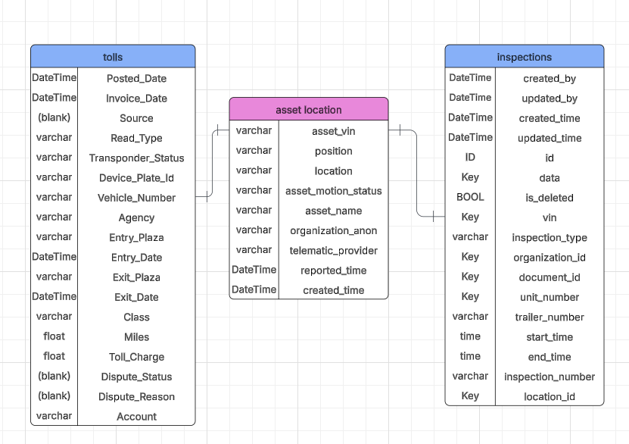
ER Diagram

Slide 55
#1: To Identify Customer (not driver, but who leased out the Trailer)
Use Telematics data to identify the VIN of the trailer which can connect to Customer
Driver passes through a Toll
Wabash gets charged for Toll
What happens here?
To Identify Driver

Slide 56
TrailerHawk identifies a damage in an inspection report, and finds the report prior to that without a damage
If Pre and Post exists, we can attribute to the customer. If Pre doesn't exist, then
Potential Trips which could have caused the damage
Purdue team uses Telematics data to identify all trips which occurred between those two reports
Start_Location | Start_time | End_Location | End_time | Customer
Yard/Location A | FEB 1 1:00PM | Yard/Location B | FEB 1 3:00PM | Customer A
Yard/Location B | FEB 7 2:00PM | Yard/Location C | FEB 10 3:00PM | Customer A
Yard/Location C | FEB 21 3:00PM | Yard/Location D | FEB 22 8:00AM | Customer B
We don't have enough data to say which customer would have caused Damage

Slide 57
Project Update 28-Feb

Slide 58
Project Update 12-March

Slide 59
Old Slides

Slide 60
Open Questions
Overall Objective
How is trailer borrowed? Is it a specific customer or a fleet or both?
Are there any key metrics which is tracked and should be moved with this project?
Should we eat the cost or charge our client? What’s the criteria deciding if we should charge the client or not?
It is mentioned "Real-time" - How is it done now? And how should it be?
About the Data
How can we access the data?
If we want to conduct cost management or estimation, do you have further data related to situations where damages cannot be attributed to a specific driver, such as the average amount of loss over specific time periods or any other relevant metrics?

Slide 61
Data Required
Table | Required Details
Booking | booking_id, customer_id, booking_start_time, booking_end_time
Customer | customer_id, license_plate
Toll | toll_charge_id, license_plate, timestamp
Inspection Report | inspection_report_id, booking_id, pre_or_post
Unique ID

Slide 62
What are the Business Benefits if this project is implemented?
Cost Management
Automated Operations
Data-Driven Decisions
Customer Experience
The predictive system will track and assign costs to specific drivers and lanes. This will reduce errors and help Wabash handle billing disputes with customers.
This project will use AI to check trailer damage from pictures instead of having people do it which will make the work faster and more accurate.
The analytics tools will show cost patterns and potential problems. Managers can take actions before small issues become major concerns.
Clear cost tracking will build trust with customers. The accurate billing and fair charges will lead to higher customer satisfaction rates.

Slide 63
Business to Analytics – How does Data help?
Data | What it contains
Trip inspections reports | Details and pictures of self-inspection of trailer before and after use of trailer
Telematics data | Geolocation of the trailer
Toll data | license plate, location, amount
Modeling: Develop models/queries to triangulate tolls and damages to specific drivers, lanes, or trailers in real time.
Integrate telematics, tolls, and trailer data for insights.

